Slide 1
Whether Weather Drives Crime
An attempt to find if and how weather and crime are related

Slide 2
Whether Weather Drives Crime Agenda
Introduction, Problem Statement and Scope
Methodology
Day of Week vs Crime
Findings
Conclusions
Precipitation vs Crime
Findings
Conclusions
Temperature vs Crime
Findings
Conclusions
Moon Phase vs Crime
Findings
Conclusions

Slide 3
Introduction Problem Statement and Scope
Problem Statement
There are a lot of factors that affect the crime rate. This project aims to understand the effect of the following 4 factors on the crime rate.
Whether it’s a weekday or a weekend
Precipitation
Temperature
The Moon phase
Scope
The findings presented i

Slide 4
Whether Weather Drives Crime Agenda
Introduction, Problem Statement and Scope
Methodology
Day of Week vs Crime
Findings
Conclusions
Precipitation vs Crime
Findings
Conclusions
Temperature vs Crime
Findings
Conclusions
Moon Phase vs Crime
Findings
Conclusions

Slide 5
Methodology How we went about doing it
CONTENT

Slide 6
Whether Weather Drives Crime Agenda
Introduction, Problem Statement and Scope
Methodology
Day of Week vs Crime
Findings
Conclusions
Precipitation vs Crime
Findings
Conclusions
Temperature vs Crime
Findings
Conclusions
Moon Phase vs Crime
Findings
Conclusions

Slide 7
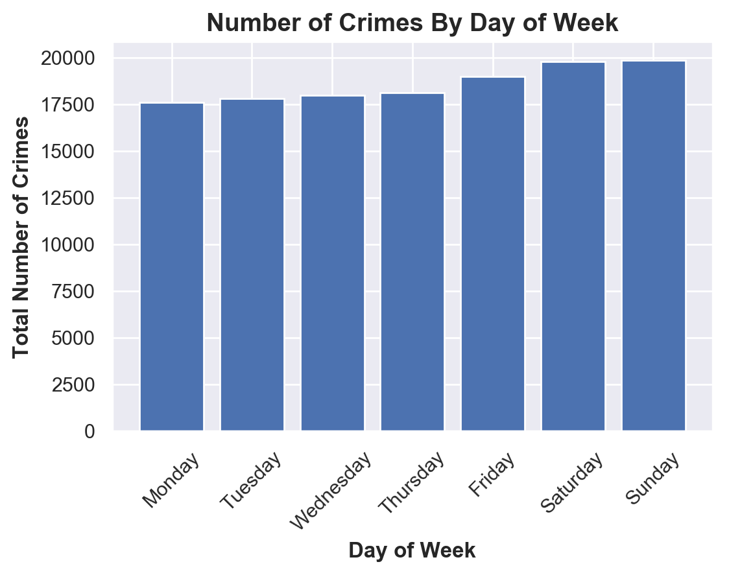
Day of Week vs Crime Findings

Slide 8
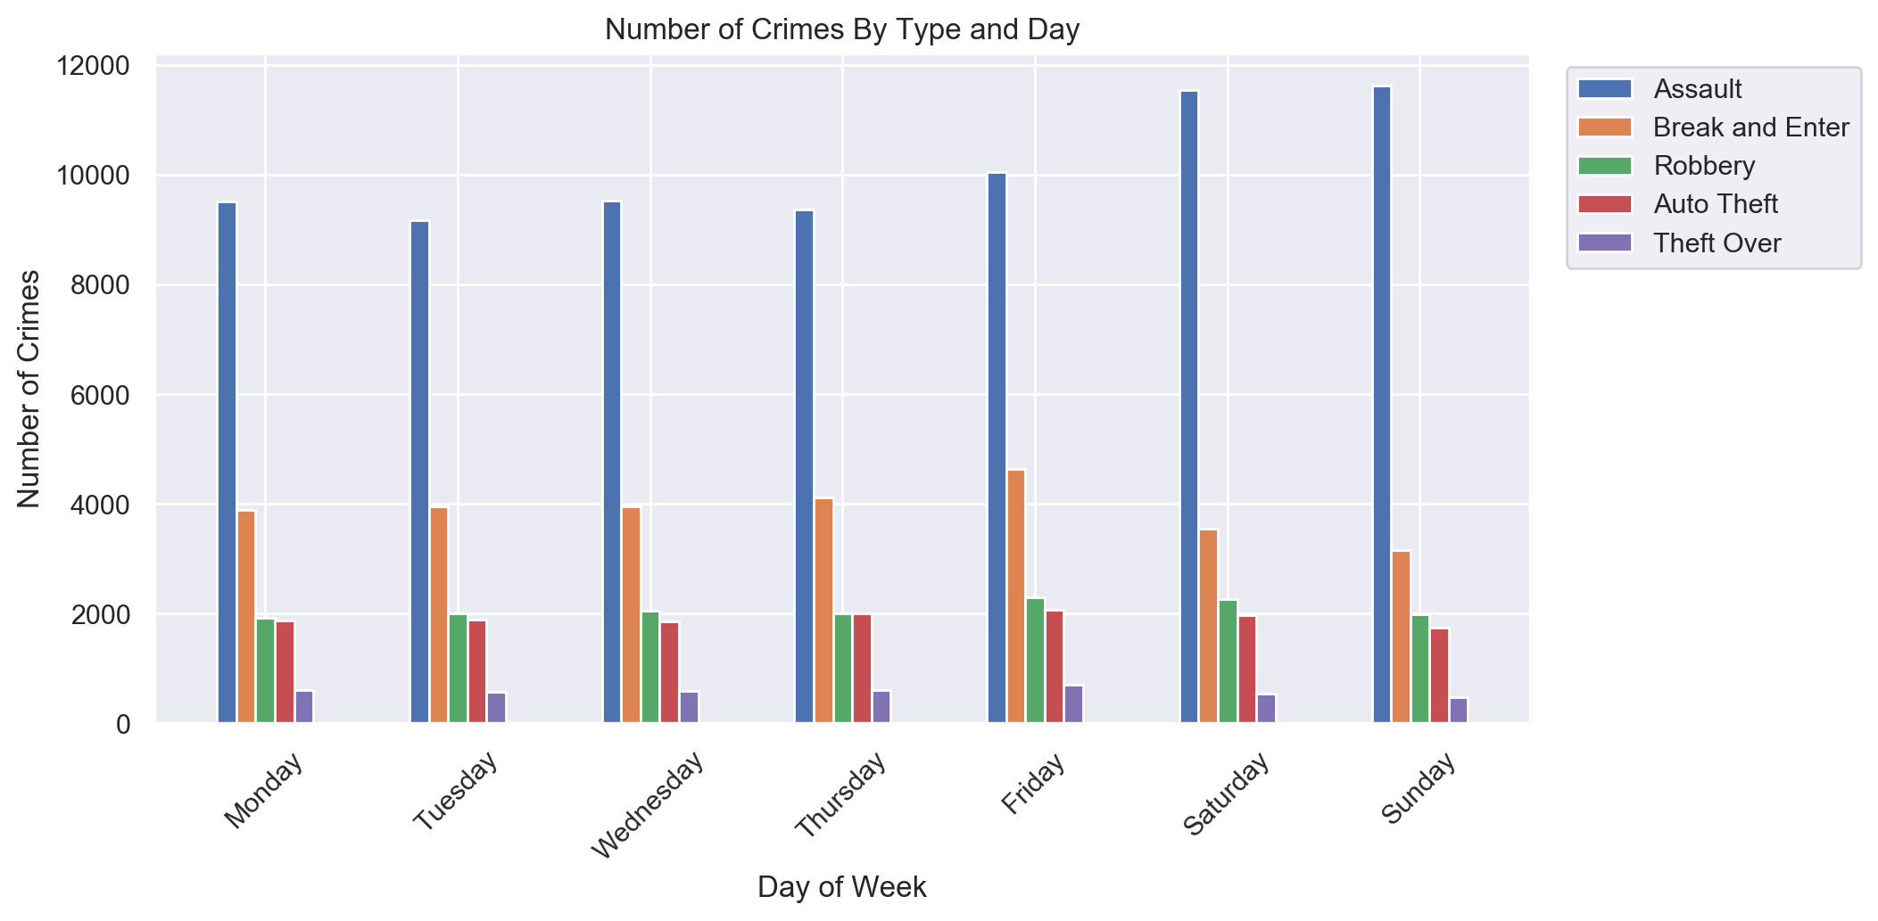
Day of Week vs Crime Findings

Slide 9
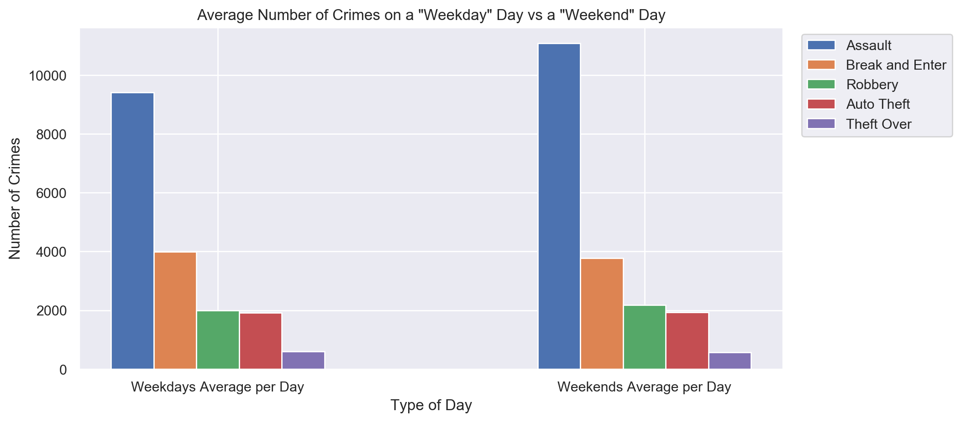
Day of Week vs Crime Findings

Slide 10
Day of Week vs Crime Conclusions and Limitations
From the 5 categories of crime considered for this project, ‘Assault’ has by far the highest number of occurances
The total crime rate goes up during the weekend.
The spike on the weekends is primarily driven by ‘Assault’.
‘Break and Enter’ peaks on Fridays and goes down to the lowest over Saturdays and Sundays.

Slide 11
Day of Week vs Crime Conclusions and Limitations
Conclusions
The total crime rate goes up during the weekend, primarily driven by ‘Assault’.
‘Break and Enter’ peaks on Fridays and goes down to the lowest on Sundays through Saturdays.
Limitations
The only factor considered for this section of the project is Weekday/Weekend vs Crime. Whereas there can be a lot of factors that affect crime.

Slide 12
Whether Weather Drives Crime Agenda
Introduction, Problem Statement and Scope
Methodology
Day of Week vs Crime
Findings
Conclusions
Precipitation vs Crime
Findings
Conclusions
Temperature vs Crime
Findings
Conclusions
Moon Phase vs Crime
Findings
Conclusions

Slide 13
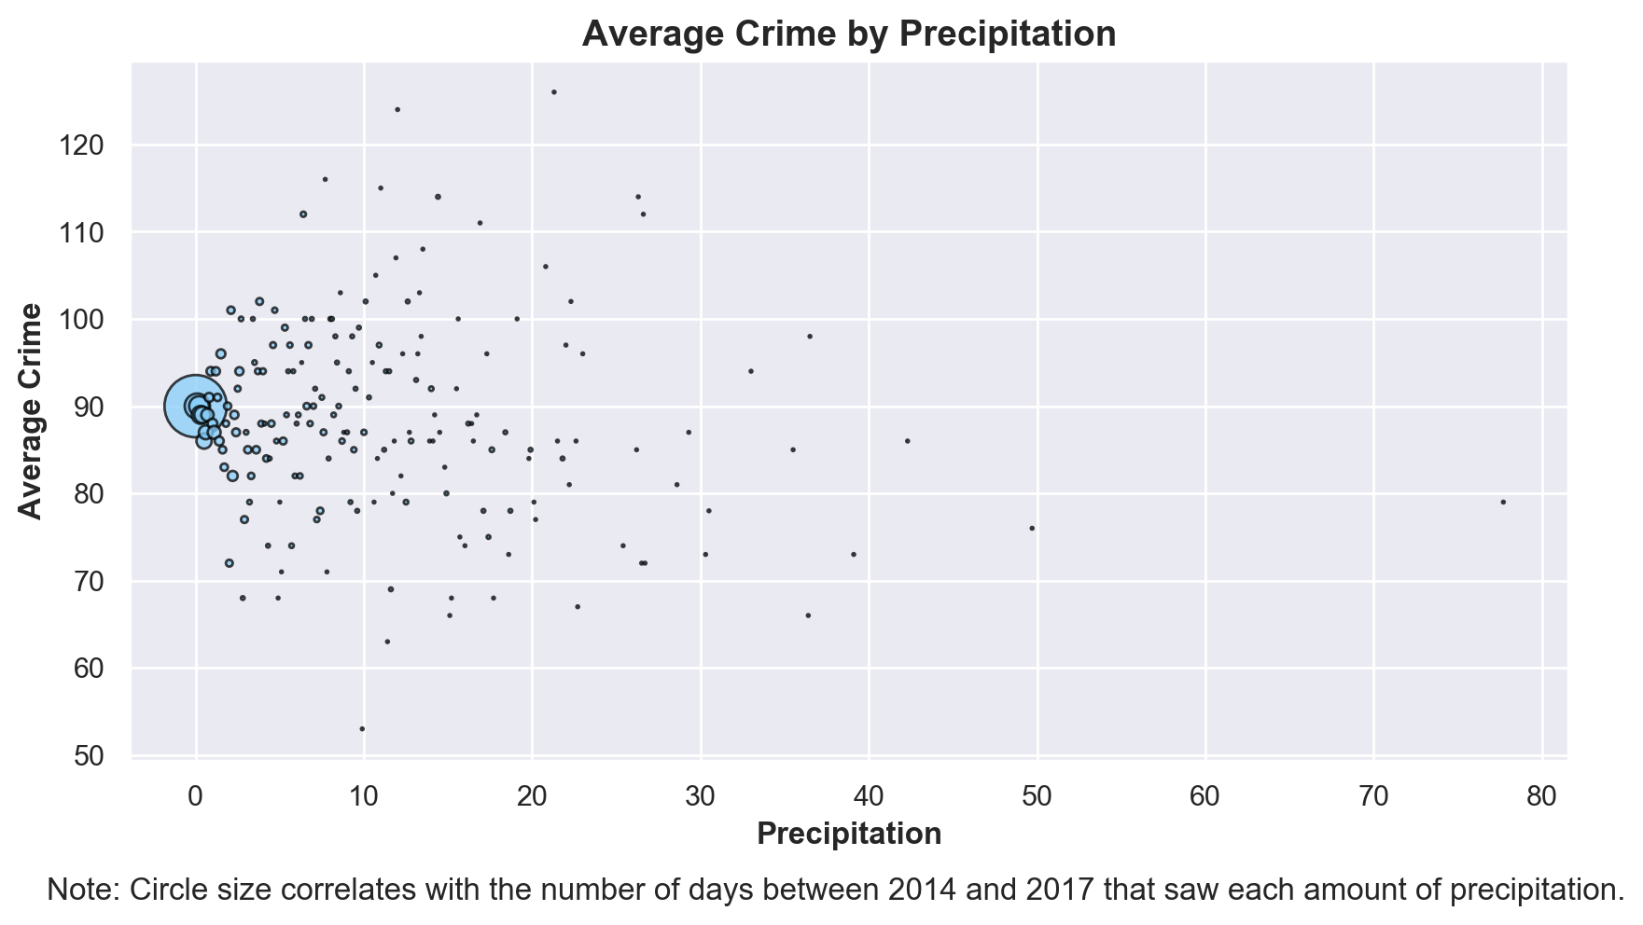
Precipitation vs Crime Findings

Slide 14
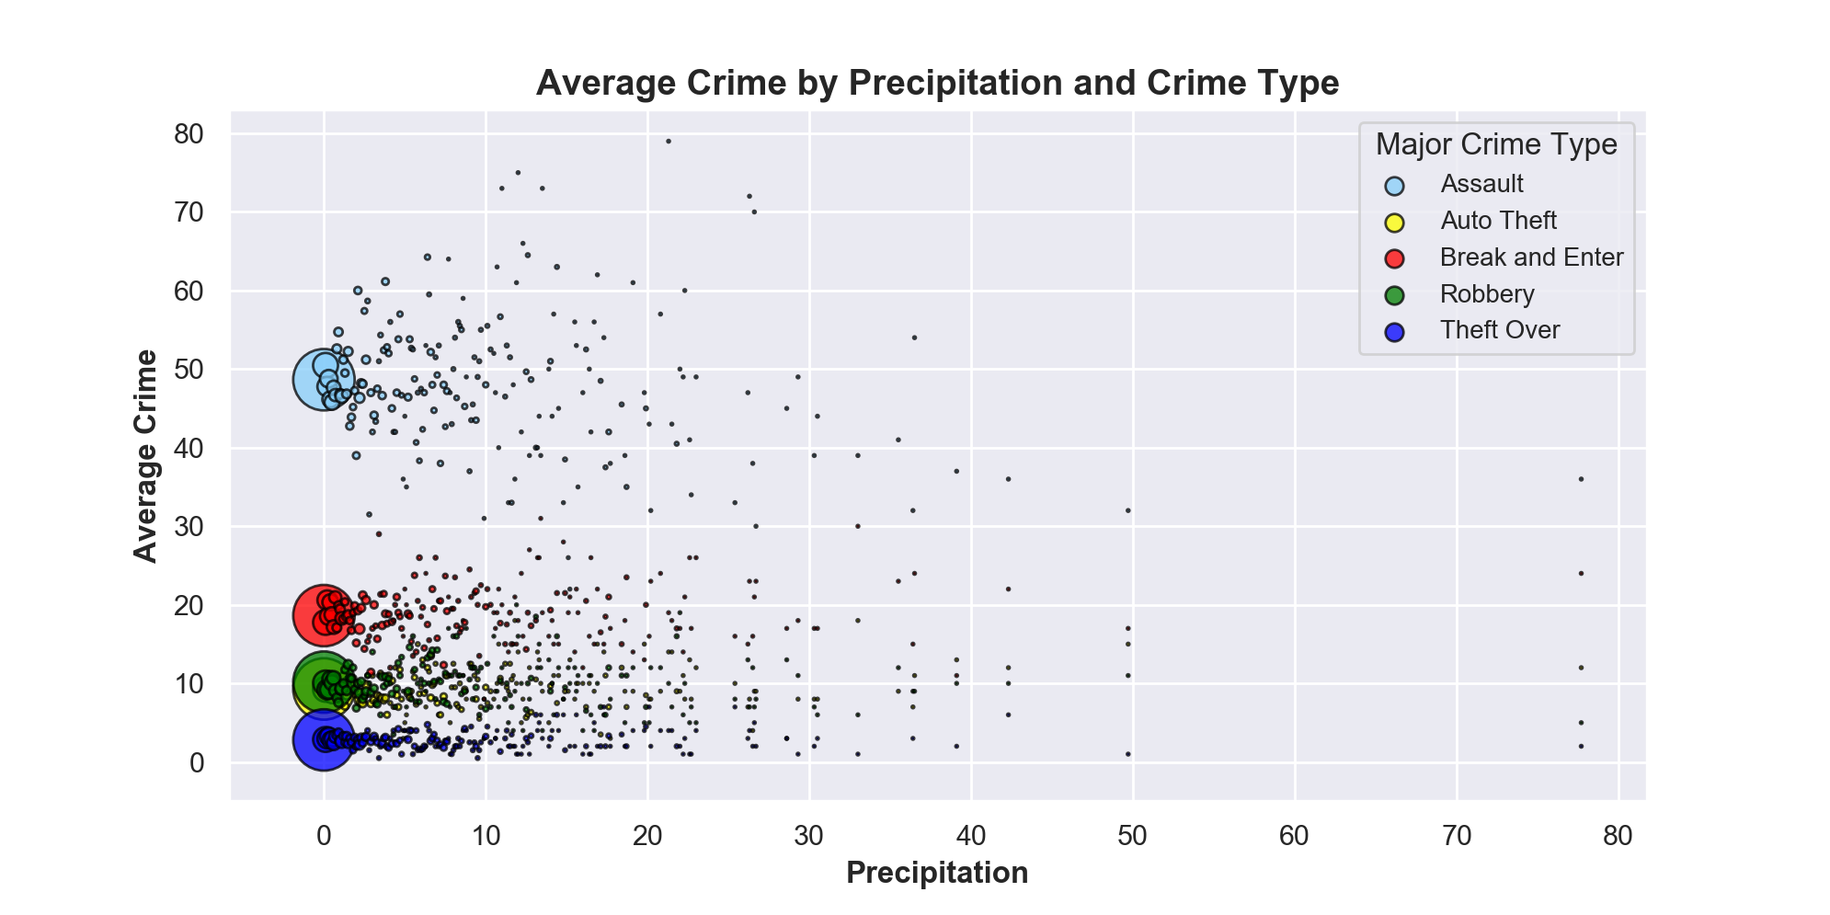
Precipitation vs Crime Findings

Slide 15
Precipitation vs Crime Conclusions
Conclusion:
Random spread of all and each type of crime
No obvious correlation between precipitation and crime
Scatter plot indicates similar pattern on days with rain and days without rain in terms of average crime rate
Limitations:
Way too many days (6-7 times more) with no or very small precipitation
Dataset is very saturated in the no or small precipitation region
Separation into low, medium and high precipitation could be very subjective

Slide 16
Whether Weather Drives Crime Agenda
Introduction, Problem Statement and Scope
Methodology
Day of Week vs Crime
Findings
Conclusions
Precipitation vs Crime
Findings
Conclusions
Temperature vs Crime
Findings
Conclusions
Moon Phase vs Crime
Findings
Conclusions

Slide 17
Temperature vs Crime Findings
CONTENT

Slide 18
Temperature vs Crime Conclusions
CONTENT

Slide 19
Whether Weather Drives Crime Agenda
Introduction, Problem Statement and Scope
Methodology
Day of Week vs Crime
Findings
Conclusions
Precipitation vs Crime
Findings
Conclusions
Temperature vs Crime
Findings
Conclusions
Moon Phase vs Crime
Findings
Conclusions

Slide 20
Moon Phase vs Crime Findings
CONTENT

Slide 21
Moon Phase vs Crime Conclusions
CONTENT

Slide 22
Thank You

